Slide 1

Empowering Parents: Session #2
Welcome Back!
April 30, 2025
Notes:
Welcome back everyone! I am so happy to see your shining faces on this – the last evening of April! Summer is calling, and I just can’t believe how quickly time is slipping by! Again, I am grateful and honoured to hold space with you as we share our stories and make time to learn and connect. Welcome to our new participants tonight – we are thrilled to have you. I have been updating our website, and will store copies of our presentations there for anyone curious to look back at what we have done so far. I am also very happy to email you resources – just let me know what you prefer.

Slide 2

Grateful and humbled to be a guest on the beautiful and unceded territory of the Lheidli T’Enneh.
Notes:
I am grateful and humbled to be joining you on this, the beautiful and unceded ancestral territories of the Lheidli T’Enneh, on whose land we live, work, and play.

Slide 3


Reminder!
Notes:
During our time together, we will be stopping frequently to think, jot down some quick notes before we return together to discuss. It is handy to have a pen or pencil along with some paper. If you have any questions or ponderings that come up during our discussions, write those down as well – I will always leave time during and after our discussion to address any questions that come up.

Slide 4


Disclaimer
https://northernbc.cmha.ca/find-help-now/
Notes:
Disclaimer:
I want to acknowledge that while I am a teacher and a graduate student, I am not a licensed therapist or mental health professional. The purpose of these sessions is to offer support, share educational insights, and provide a space for reflection and learning—not to provide therapy or clinical advice.
If at any point during our discussions you feel overwhelmed, uncomfortable, or in need of additional support, please know that help is available. I encourage you to reach out to a qualified mental health professional or access support services through the Canadian Mental Health Association at https://northernbc.cmha.ca/find-help-now/. Please know that your safety and well-being is incredibly important to us – please do not hesitate to reach out if you need support.

Slide 5
Shape of Our Evening
2 Grounding/Check-In/Review Last Session
3 Group Share Out: Take Home Task Last Week
1 Review of Group Norms/Review of Last Session
4 Negativity Bias
5 Character Traits
6 Identifying Strengths
7 Take Home Task
8 Final Thoughts & Questions
Notes:
As for the shape of our evening, we will review our group norms. We will have a check in, and spend time reviewing what we learned last week. We will take some time to share out our take home task from last week – describing your child from their point of view. We will have a chance to explore what “negativity bias.” We will look more deeply at character traits, and I will show you several examples of how we might work to identify strengths in our children. I will have another take-home task for you to explore, and I will of course leave time at the end for final thoughts and questions.

Slide 6
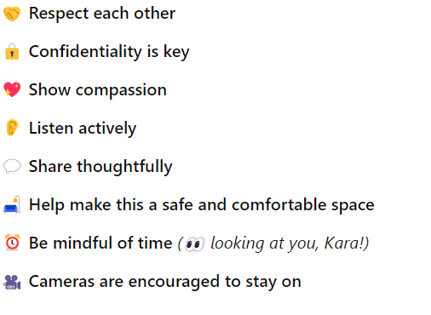
Group Norms

Slide 7

Check-In
💛 Let’s Begin Together
🌿 Grounding Exercise – Take a moment to settle in
✍️ Quiet Think & Write – What’s giving you energy as a parent right now? (5 mins)
🗣️ Group Share – Let’s hear from each other (10 mins)
Headspace | Mini meditation | Breathe - YouTube
Notes:
I have another little grounding exercise to help us to settle in as we arrive together this evening. I will play another short video from Headspace. Afterwards, we spend 2 minutes thinking, followed by 5 minutes journaling around the question of “what is giving you energy as a parent right now?” what is breathing life into your experience as a parent, what is giving you confidence, hope, strength… after our think and write time, I will bring the group back together for a share out.

Slide 8
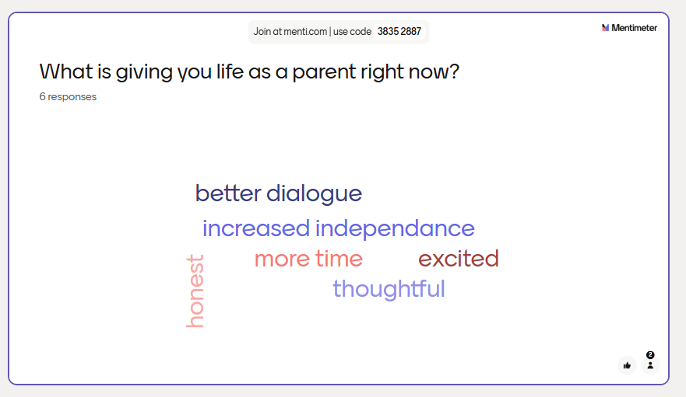
What is Giving You Life Right Now?

Slide 9
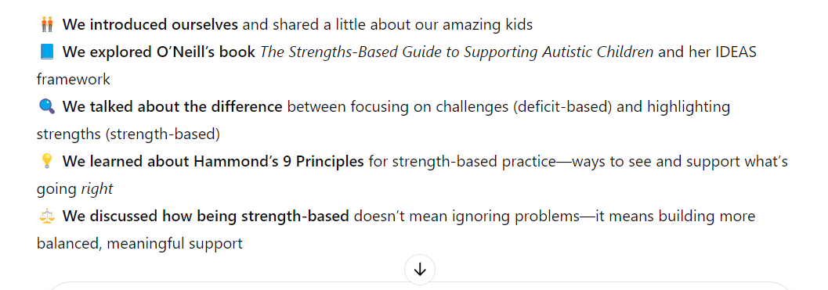
Last Session, We…

Slide 10

Take Home Task Review: Break Out Room Discussion
(10 mins)
🌟 Describing your child at their best.
Notes:
Okay, I wanted to spend a bit of time sharing out our take home tasks from last week. Last week I asked you to describe your child from their point of view…thinking about what strengths come to mind, what brings them life, energizes them. I wanted you to think about where they are and what specific activities they might be engaging in. I want us to spend about 10 minutes in a breakout room sharing about your child at their best. We will meet back and share out some key learnings.

Slide 11



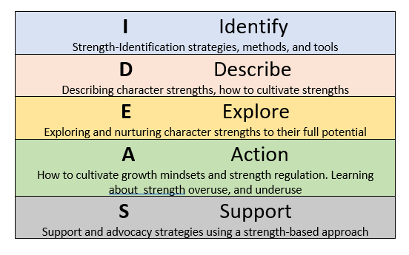
We are here.
Notes:
Last week, we spoke about strengths. Tonight, on our road trip of learning, we will stop at Identify, where we will learn how we identify strengths in our children. As parents, we and our children are the real experts in the room. As parents, you have a fantastic knowledge of your child and their many strengths and abilities. Tonight, I want to give you some tools to deepen your observational skills around your child’s strengths. Many of the activities I will speak about are co-operative activities, meant to be completed with your child. I am aiming to provide activities that may suit a wide range of communication and learning styles, but if you do have any questions about how you might modify activities to fit your child’s communication or learning profile, please let me know.

Slide 12
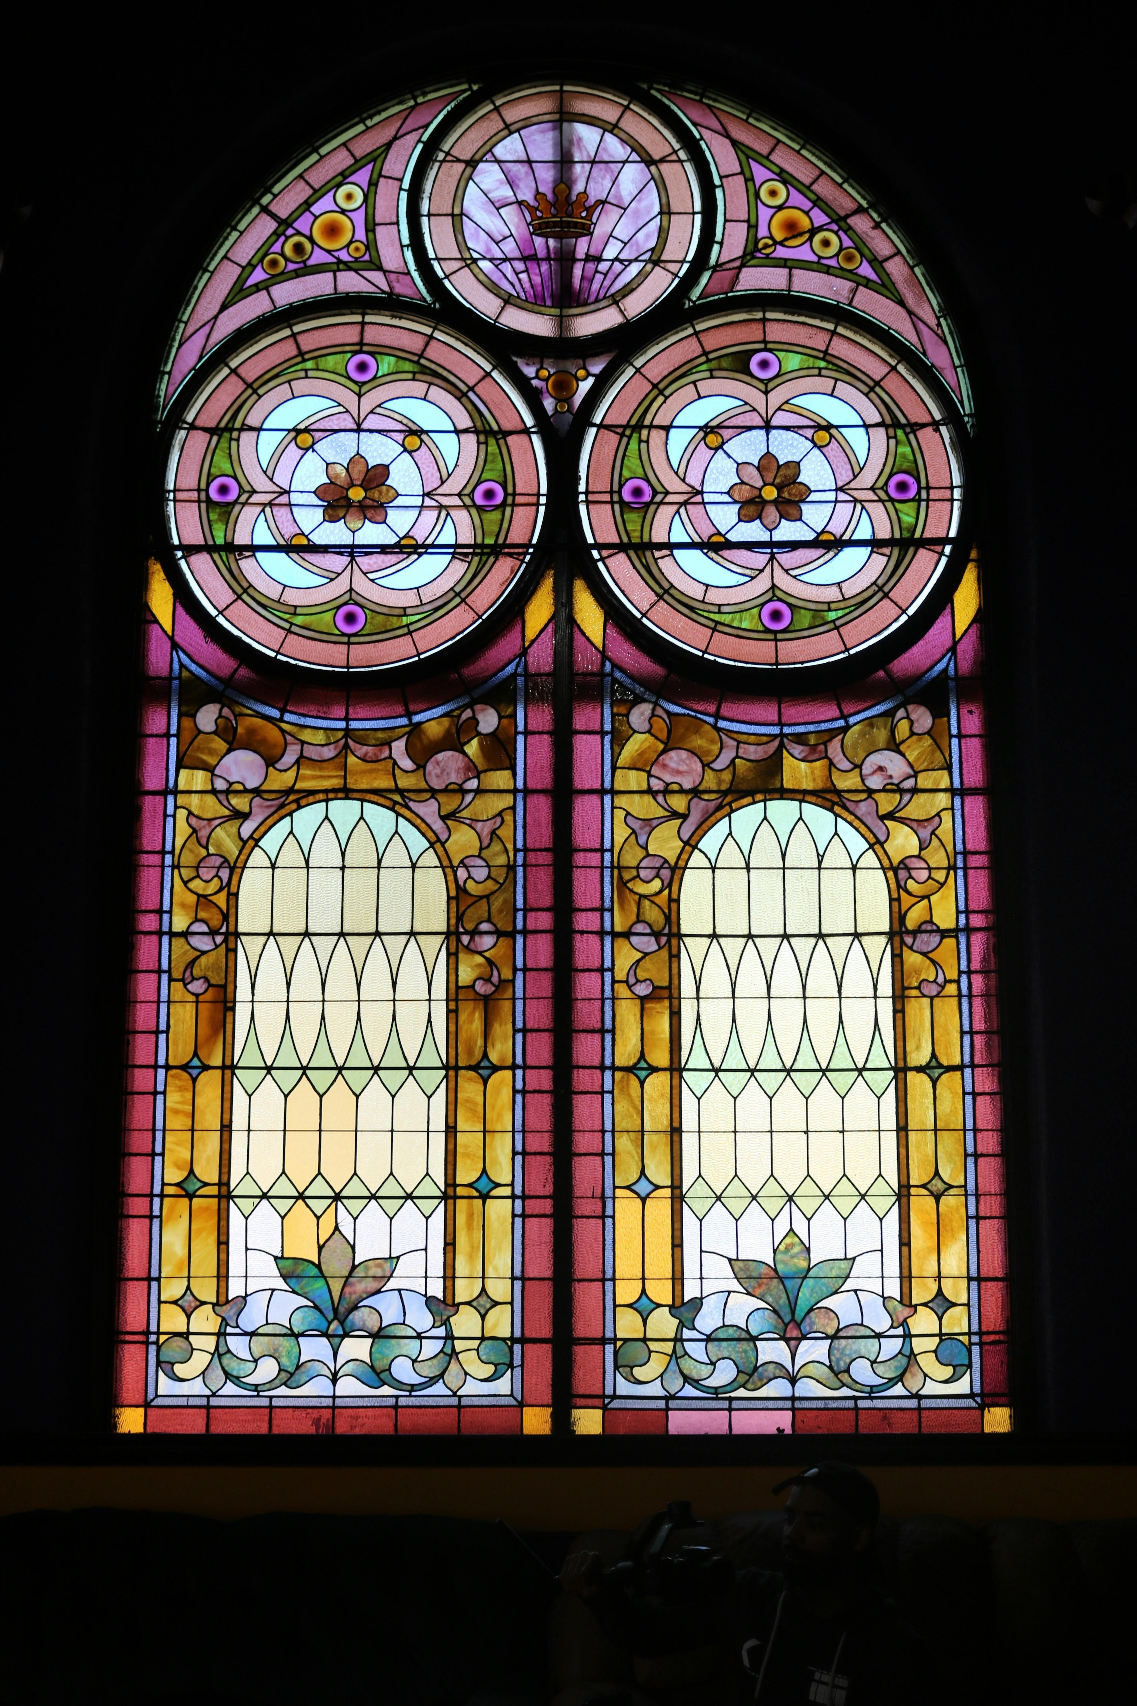
Look at this window. What do you notice?
Notes:
Before we launch in, take a moment, look at this window, pop into the chat what you notice about this window.
Very interesting, despite this being a beautiful and intricate stained-glass window, our eyes were drawn to the brown splotch. What is that?

Slide 13
Negativity Bias: The Dirty Window Syndrome
Can you think of a time when you noticed negativity bias in your parenting or personal life?
What helped you move through it, or what changed how you saw things?
Smith, A. (2017, July 2). Seeing through the dirty window: Ending negativity. My Four and More. https://myfourandmore.com/seeing-through-the-dirty-window-ending-negativity/
Notes:
Negativity bias is our natural tendency to focus more on negative experiences than positive ones. In an article called “Seeing through the dirty window,” Anne Smith (2017) describes it like a splotch on a stained-glass window—while the whole window is beautiful and full of vibrant colors, that one dark stain can grab our attention and overshadow the rest. Just as the stain distorts our view of the window, negativity bias can misrepresent how we see situations… focusing on what’s wrong instead of what’s right. Understanding this bias helps us intentionally shift our focus to the positive, allowing the whole, beautiful picture to emerge. We can think of the negativity bias as a survival mechanism that helped our ancestors stay alert to potential dangers. By focusing more on harmful or threatening experiences, we were more likely to notice risks and protect ourselves. In today’s world, this bias continues to shape how we respond to stress or challenges, keeping us on high alert. While it served a protective role in the past, it can sometimes cause us to focus more on the negative aspects of everyday life, making it essential to shift our focus to the positive when we can do so consciously.
I want us to think about a time when you noticed negativity bias in your parenting or personal life. For example, with my son Erik, I used to focus on the fact that he struggled to make eye contact, and I would get caught up in thinking of that as a “problem.” It was easy to get stuck there and worry about how that might affect his ability to connect with others. But over time, I realized I was overlooking his strength…like his fantastic ability to solve problems, his genuine kindness toward others, and the passion he shows when he’s engaged in his favorite activities. When I shifted my focus and began to celebrate those strengths, I saw a fuller, more positive picture of who Erik is and how he’s growing.

Slide 14
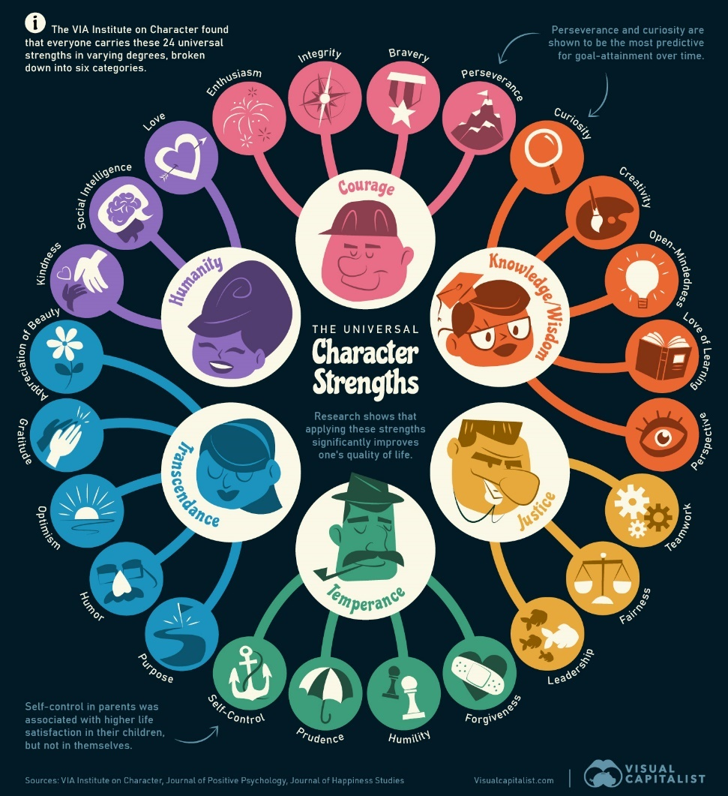
What are character strengths?
Nuefield, D. (2023) https://www.visualcapitalist.com/24-universal-character-strengths-in-one-graphic/
Notes:
Character strengths, as defined by Parks & Seligman (2004), are positive traits that are reflected in how we think, feel, and act. These strengths, including kindness, perseverance, curiosity, and honesty, enhance our well-being and ability to confidently and successfully thrive in the long term. They influence how we think, solve problems, connect with others, cultivate our physical and intellectual abilities, and grow as individuals. By recognizing and cultivating these strengths, we can enhance our resilience, strengthen our relationships, and experience a greater sense of fulfillment in life.

Slide 15
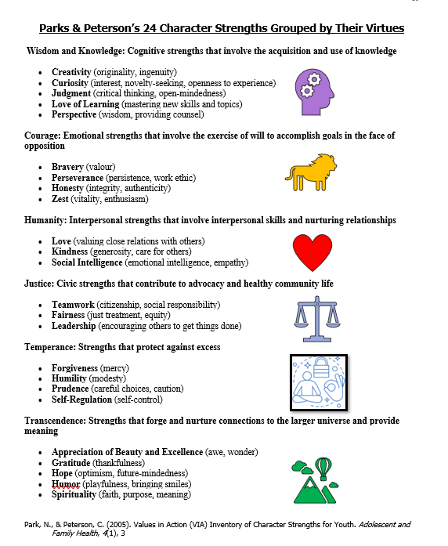
Notes:
Here is a closer look at Parks and Peterson’s 24 Character Strengths.
Grouped into six core virtues.
Wisdom and Knowledge encompass cognitive strengths like creativity, curiosity, and perspective.
Courage involves emotional strengths (bravery, perseverance, and zest).
Humanity focuses on interpersonal skills (love, kindness, and social intelligence).
Justice includes civic strengths (teamwork, fairness, and leadership).
Temperance highlights strengths that protect against excess (forgiveness, humility, and self-regulation).
Finally, Transcendence reflects strengths that foster meaning and connection (gratitude, hope, and spirituality).
Parks and Seligman’s (2004) 24 Character Strengths provide educators with a comprehensive and research-backed framework for recognizing students’ unique abilities.
Overall, the research highlights that recognizing and applying character strengths results in growth in student independence, resilience, and personal and relational success.
Long-term research, such as the Dunedin Multidisciplinary Health and Development Study, highlights that traits like conscientiousness and emotional stability in childhood are strong predictors of adult outcomes, including health, relationships, and career success (Silva, 1990).

Slide 16
How Do We
Identify Strengths?
Notes:
How do we identify strengths? I want to acknowledge that you have already started this work long ago, and as parents, you have a deep wealth of knowledge around your child’s strengths – even our take-home task was a sneaky way of affirming one method of identifying strengths, and that was describing our child at their best

Slide 17
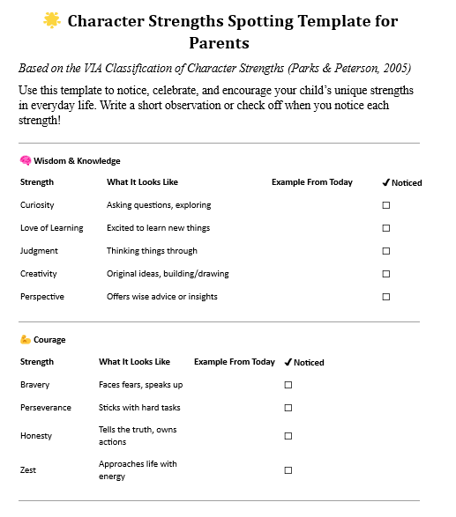

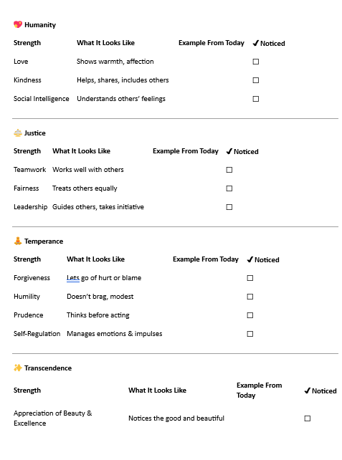

Strength Spotting
Definition: Observing children in daily activities to identify strengths.
Method:
Observe at different times, with different people, and during various activities.
Pre-record strengths and look for evidence over time.
Tool: Use a checklist to track observed strengths, their frequency, and contexts.
Notes:
Strength spotting comes from Claire O’Neill’s book, the The strengths-based guide to supporting autistic children: A positive psychology approach to parenting. Strength spotting involves intentionally observing children during various activities and times of the day to identify their strengths in action. O’Neill (2023) suggests recording potential strengths and gathering evidence over time to confirm them. Using a checklist such as the example here to track strengths, their frequency, and the contexts in which they are most evident can provide valuable insights.
I have created my template based on this information that I am happy to share with each of you. This Character Strengths Spotting Template is a simple way to notice and celebrate your child’s everyday strengths, based on the VIA framework developed by Peterson and Parks. By jotting down small moments or checking off strengths you observe, you’ll start to see patterns in what makes your child shine—and how to support them with more confidence and joy. This template can be used over a day a week, I could likely tinker with it to make it worthwhile for a month long observation. I will put it in the chat.

Slide 18

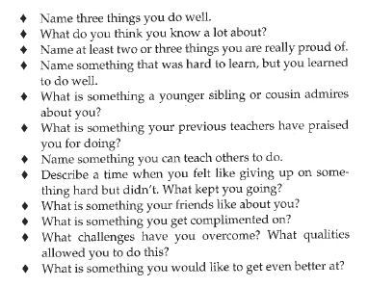
"Fireside Chats" – Parent-Child Interviews
Purpose: Build connections, centers child voice and experience, and sets a positive tone
Focus Areas: Children share interests, strengths, and learning goals.
Benefits:
Uncover new strengths.
Reflect on and adjust goals.
Foster student self-awareness and growth.
(Baron, 2023, Appendix 4: “A Strength-Based Questionnaire”)
Notes:
As a teacher, having interviews with my students is one of my favourite ways of getting to know them and get a better idea of their interests and strengths.
Why Strength-Based Conversations Matter for Our Kids
Talking with our kids about their strengths helps us understand their unique interests, experiences, and perspectives.
By asking open-ended questions, we can uncover their hidden talents, passions, and value…things that may not always be evident in everyday life.
These conversations give our kids a chance to share their thoughts, boosting their self-awareness and confidence.
It also strengthens our relationship with them, creating a space of trust and open communication.
Reflecting on their strengths helps our kids feel more confident and motivated, making these kinds of conversations a powerful tool for supporting their growth and success.

Slide 19
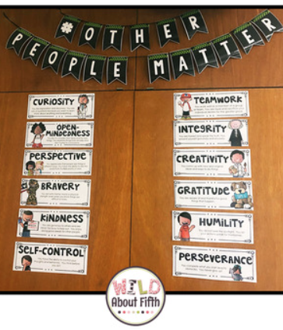
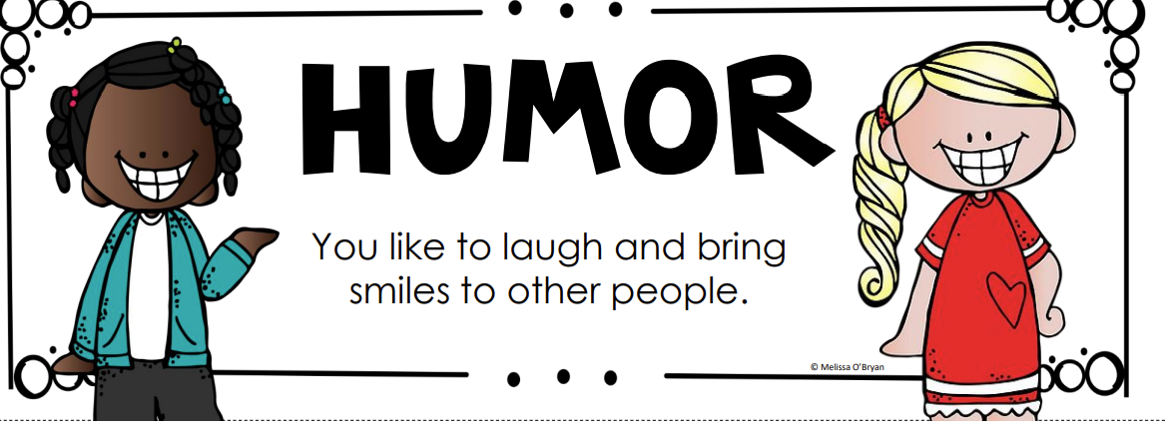
Strength-Cards https://www.teacherspayteachers.com/store/melissa-obryan-wild-about-fifth
Notes:
Strength cards are another great way to explore strengths with children. O’Neill has some examples of strength-cards in her book, but I found these colourful and adorable cards from an online teaching resource called Teachers Pay Teachers. These creative, kid-friendly activities are designed to help children explore and express their unique character strengths in fun and meaningful ways. I have included 10 ways you can use strength cards here - playing games like matching the card with a description – like “I noticed you shared with your brother today – what strength do you think this is?” or Role playing – acting out situations where we demonstrate things like bravery or patience, have your child identify which strengths they think best describe them, you can use these cards for story telling, or even get the whole family involved to take turns picking a card and describing how they see that strength showing up in other members of the family. These cards really help to build up your family’s knowledge and familiarity with what the strengths are and what they mean.

Slide 20
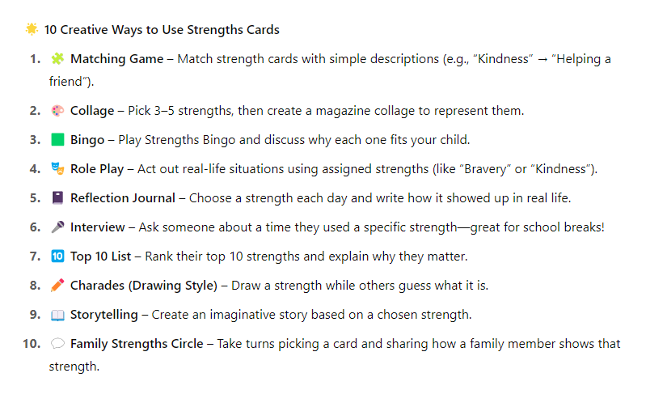

Slide 21
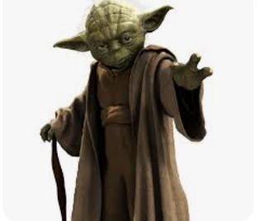
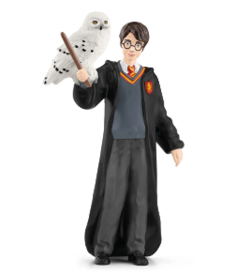


Using Fictional Characters for Strength Identification Identification
Challenge: Some neurodiverse learners may struggle to identify their strengths.
Solution: Use fictional characters from books or media (e.g., Star Wars, Harry Potter, Pokémon) to help students explore strengths.
Method:
Discuss and brainstorm the strengths of characters during read-alouds.
Relate character strengths to children’s abilities.
Benefit: This approach works particularly well for autistic children who have a detailed knowledge of characters.
Notes:
We will chat more about this particular method next week
Using books, movies, and cartoons can help neurodiverse learners identify strengths by connecting them to fictional characters. This approach allows students to explore strengths in a relatable and non-personal way, making it especially effective for autistic students who often have detailed knowledge of characters from series like Star Wars or Harry Potter, but may struggle to identify their own strengths.
For example, Throughout the Harry Potter books, Harry consistently stands up for what's right—even when it's scary, unpopular, or dangerous. He faces powerful enemies, stands by his friends, and acts with bravery in the face of uncertainty and fear. His courage isn't just about fighting battles; it's also about being honest, loyal, and standing up for others.

Slide 22
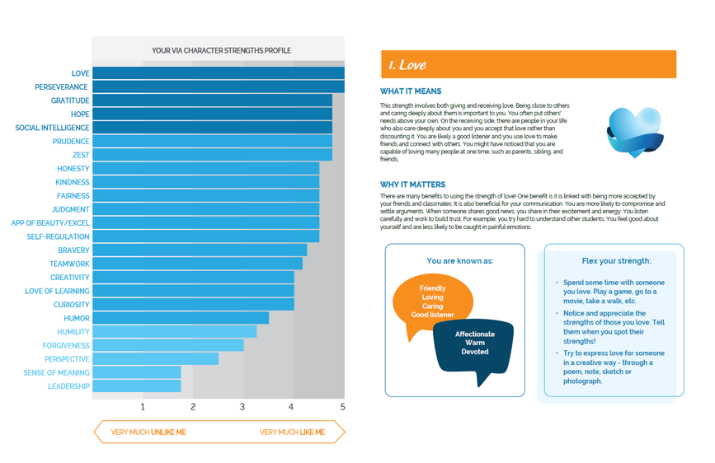
Values in Action Survey
Purpose: A free online survey to identify strengths in children (ages 10+).
Structure: 96 questions, takes about 15 minutes to complete.
Support Needed: Neurodivergent learners may require parent support to read and explain questions.
Results:
  Report lists top, middle, and lower strengths.
  For $10, a detailed report includes a graph of strengths and tips for nurturing them.
Notes:
The VIA Classification of Strengths Youth Survey, developed by Parks and Peterson (2005), is a free online tool for identifying strengths in children ages 10 and up, though younger children can also benefit with teacher support. The survey consists of 96 questions and takes about 15 minutes to complete. Some neurodivergent learners may require additional assistance, such as having the questions read and explained. After completion, students receive a report detailing their top, middle, and lower strengths. For a small fee, a more comprehensive report is available, offering a detailed graph and guidance on how to nurture and develop these strengths daily. Here is an example of my son’s VIA survey report:

Slide 23
Notes:
Here is a look at Erik’s top strengths: Love, Perseverance, Gratitude, Hope, and Social Intelligence. Erik’s results are a perfect example of why we should never stereotype our neurodivergent learners – Autistic students, especially students like Erik, who we used to traditionally refer to as having Asperger’s Syndrome, are too often “type cast” as unfeeling, having no filter, being unempathetic or cold – the loveable human robot – think “Sheldon,” from Big Bang Theory. I was not surprised to learn Erik's top strength was love. While he sometimes struggles to understand where some emotions are springing from, he is a deeply feeling individual with an immense capacity to express and receive love, empathy, and affection. He is very sensitive, and cares very very deeply about the people with whom he is close. Family is everything to him. Here is an example of what the first page of his report looks like. I really love how visual the report is and how it breaks the strengths down into kid-friendly terms, with handy ways to “flex” each strength. I would find this so handy to use with students and their families.

Slide 24
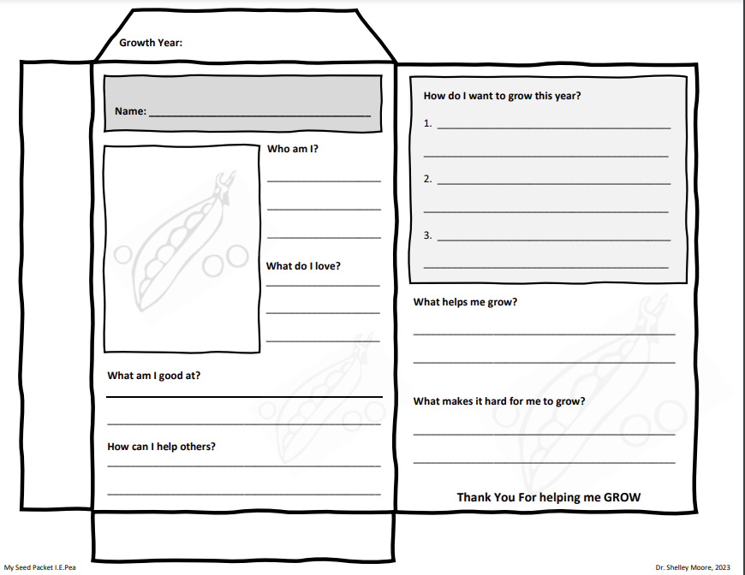
Seed Packet Strength Activity
Resource: From Shelley Moore's “Blog Some Moore.”
Activity: Students or families complete seed packets to represent strengths.
Symbolism: The seed reminds us to nurture strengths for growth.
Home Extension: Create a communal “strength” flower garden to showcase diverse strengths
Notes:
I love this next idea, and I’ve used it with great success in our family too. Shelley Moore’s Strength Seed Packets activity encourages kids to recognize and nurture their own strengths, which are symbolized as seeds that need care to grow to their full potential. It’s a wonderful way to help your child reflect on their unique abilities. You can do this activity together at home or even as a family project! As a fun extension, families can create a “strength flower garden” to celebrate everyone’s strengths and show how diverse and valuable each person’s strengths are. I have used these in IEP meetings to describe the strengths we are seeing at school, and talk about how the student wants to grow. I always tuck some seeds, like some sunflower seeds, inside.

Slide 25
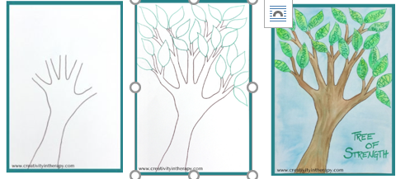
Tree of Strength Activity
Art as a Medium: Finding creative ways to uncover student strengths.
Adaptability: Suitable for all grades and ability levels.
Activity: Create a “Tree of Strength” to:
List personal strengths and coping tools.
Use the tree as a symbol of resilience and self-awareness.
Benefits: Combines creativity with cognitive engagement to help students connect with their inner strengths.
Tree of strength art directive. (2023, October 31). Retrieved from https://creativityintherapy.com/2017/04/tree-strength-art-directive/
Notes:
Art activities like the "Tree of Strength" directive from Carolyn Meh-lo-ma-ku-lu’s blog, Creativity in Therapy, are powerful tools for helping students identify their strengths. This activity combines creative expression with cognitive engagement by guiding students to list their personal strengths and coping tools as part of creating a symbolic, tree of resilience. The process is adaptable for all ages and abilities, encouraging self-reflection and connection to inner strengths, even for those who may initially struggle to recognize them. What a great way to make strengths really visible to everyone, including your child – I would hang this on the fridge and we could talk about how they used certain strengths daily, such as “tell me how you were kind to someone today.”

Slide 26
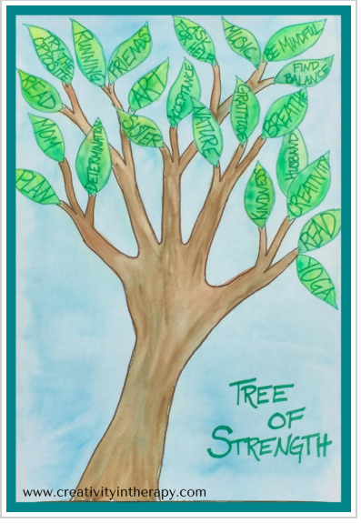
Notes:
Here is a closer look at the tree of strength. What a great project to do with your child, maybe even make a point to leave it in a really visible location in your house to celebrate how you notice your child’s strengths, or to start conversations like “how have you used your strength in kindness today?” or “How have you practiced being creative?”

Slide 27

Ask Other People in Your Child’s Life
Notes:
Last but certainly not least, lean into the other people and professionals in your child’s life – often teachers, daycare providers, grandparents or other family members will have unique insights about your child and the strengths they witness on a daily basis. Check in with these people – ask your child’s teacher to start noticing strengths and to send a little positive note home.

Slide 28
Take Home Task:
Pick a strategy we have discussed and identify your child’s top five strengths.
Information and tools have been uploaded to the website.
Notes:
As we end our session this evening, I want to leave you with another little take home task. Pick a strategy or a tool we have discussed tonight

Slide 29
Thank you!
Next Session: Wednesday, May 7th
Do you have any questions?
empoweringfamilies.ca
hagblom@unbc.ca
Notes:
Thank you again for being such a wonderful audience – this was a lot of information, research and resources to work our way through! Hopefully you found some information that you can resonate with or feel excited to try. I will update the website with resources we discussed, such as the strength spotting template, the strength cards, and the seed packet resource. Please do not hesitate to reach out if you have any questions. I will stick around for a bit if you have any questions – otherwise, I will value your time and I look forward to our session next week when we will be diving into how we describe strengths.

Slide 30
References
.
Baron, S. (2023). Teaching with a strength-based approach: How to motivate students and build relationships. Routledge.
Headspace. (2018, November 2). Headspace | Mini meditation | Breathe [Video]. YouTube. https://www.youtube.com/watch?v=cEqZthCaMpo
O'Neill, C. (2023). The strengths-based guide to supporting autistic children: A positive psychology approach to parenting. Jessica Kingsley Publishers.
Niemiec, R. M. (2017). Character Strengths Interventions: A Field Guide For Practitioners. Boston, MA: Hogrefe Publishing
Nuefield, D. (2023) https://www.visualcapitalist.com/24-universal-character-strengths-in-one-graphic/
Park, N., & Peterson, C. (2009). Strengths of character in schools. In R. Gilman, E. S. Huebner, & M. J. Furlong (Eds.), Handbook of positive psychology in schools (pp. 65–76). Routledge/Taylor & Francis Group.
Park, N., & Peterson, C. (2005). Values in Action (VIA) Inventory of Character Strengths for Youth. Adolescent and Family Health, 4(1), 35-40.
Silva P. A. (1990). The Dunedin Multidisciplinary Health and Development Study: a 15 year longitudinal study. Paediatric and perinatal epidemiology, 4(1), 76–107. https://doi.org/10.1111/j.1365-3016.1990.tb00621.x
Smith, A. (2017, July 2). Seeing through the dirty window: Ending negativity. My Four and More. https://myfourandmore.com/seeing-through-the-dirty-window-ending- negativity/
Strength-Based Collective. (2024). Building strong home-school partnerships. [PDF document].
Tree of strength art directive. (2023, October 31). Retrieved from https://creativityintherapy.com/2017/04/tree-strength-art-directive/
Wehmeyer, M. L. (2019). Strengths-based approaches to educating all learners with disabilities: Beyond special education. Teachers College Press.

