Slide 1

Empowering Parents: Session #3
Welcome Back!
May 7, 2025

Slide 2

Grateful and humbled to be a guest on the beautiful and unceded territory of the Lheidli T’Enneh.

Slide 3
Shape of Our Evening
1 Grounding/Check-In
2 Review of Group Norms
3 Review of Last Week
4 Group Share Out: Take Home Task Last Week
5 Categorizing and Describing Strengths
6 Autism Stereotypes Through a Strength-Based Lens
7 Autistic Strengths
8 Take Home Task & Final Thoughts & Questions

Slide 4


Disclaimer
https://northernbc.cmha.ca/find-help-now/
Notes:
I want to acknowledge that while I am a teacher and a graduate student, I am not a licensed therapist or mental health professional. The purpose of these sessions is to offer support, share educational insights, and provide a space for reflection and learning—not to provide therapy or clinical advice.
If at any point during our discussions you feel overwhelmed, uncomfortable, or in need of additional support, please know that help is available. I encourage you to reach out to a qualified mental health professional or access support services through the Canadian Mental Health Association at https://northernbc.cmha.ca/find-help-now/. Please know that your safety and well-being is incredibly important to us – please do not hesitate to reach out if you need support.

Slide 5
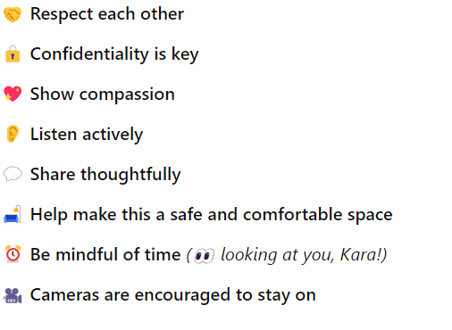
Group Norms

Slide 6

Check-In
💛 Let’s Begin Together
🌿 Grounding Exercise – Take a moment to settle in
✍️ Quiet Think & Write – What is one way my child teaches me something new or helps me see the world differently? (5 mins)
🗣️ Group Share – Let’s hear from each other (10 mins)
Welcome to Holland
Kingsley, E. P. (1987). Welcome to Holland. https://www.our-kids.org/Archives/Holland.html

Slide 7
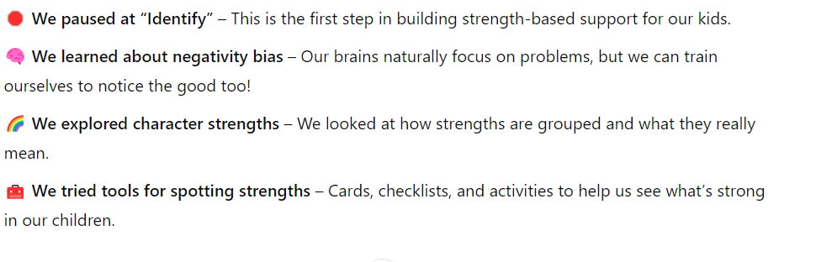
Last week…

Slide 8

Take Home Task Review:
Pick a strategy we have discussed and identify your child’s top five strengths.
Group share out. (10 Minutes)
Notes:
Last week I invited you to pick a tool to try and see if you can identify your child’s top strengths. As I am manning the ship alone today, I am going to keep us in a whole group for our share out. I invite you to raise your hand to speak – I will give each person a couple of minutes.

Slide 9
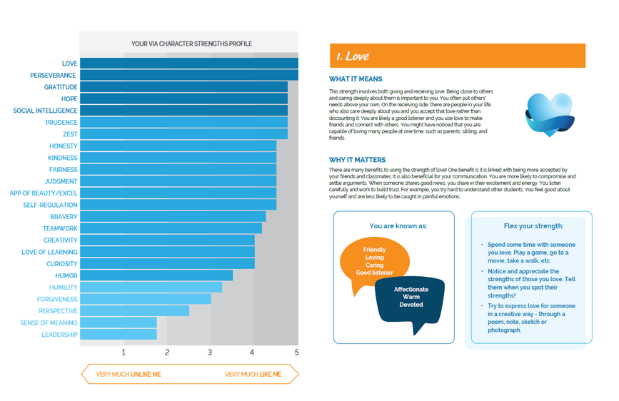
Notes:
I spoke about this last week, but as a reminder -- Erik’s top strengths include Love, Perseverance, Gratitude, Hope, and Social Intelligence. His strengths challenge common stereotypes about Autistic individuals, who are often mischaracterized as unfeeling or unemotional. Erik, for example, is deeply sensitive and has a strong capacity for love, empathy, and affection, especially toward his family.

Slide 10

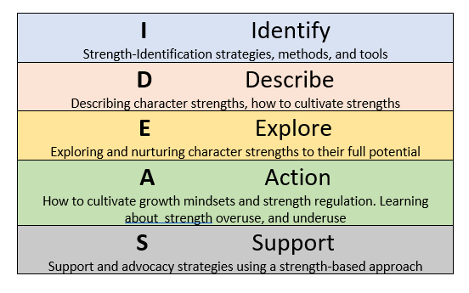


We are here.
Notes:
Tonight on our journey, we are stopping at the Describe stage – we are going to hone in on your child’s character strengths, and really get down to how we can understand what specific strengths mean. We will also look at how we can start to understand what it means to have top, middle, and lower strengths, and get a little into how strengths are classified.

Slide 11






Categorizing Character Strengths
(Niemiec, 2017)
Signature Strengths
Strengths Associated with Happiness
Lesser or Lower Strengths
Phasic Strengths
Middle Strengths
Lost Strengths
Very important to the individual
Energizing, often effortless
Strengths that have a positive impact on the individual
Includes curiosity, gratitude, love, hope, zest
Found at bottom of individual’s strength’s profile
Lesser used or underdeveloped strengths that have the potential to be further developed
Not a signature strength, but can be drawn upon when needed
More draining
i.e. bravery
Support and enhance signature strengths
Strengths that have not been nurtured, encouraged, and developed
Mostly found in adults
Notes:
In the book, O’Neill leans into research from Niemiec to help us understand how strengths can be categorized.
Signature Strengths – top strengths of an individual, key to their identity, energizing; these strengths often feel very effortless (i.e., love of learning/exploring high-interest topics)
Strengths Associated with Happiness – these are strengths that have the potential to increase feelings of joy or positively impact an individual – strengths like love, hope, zest, even appreciation of beauty and the natural world, tie into this area
Lesser or Lower Strengths – these are strengths that are near or at the bottom of one’s strength profile – they are present, but may be underdeveloped and need time and effort to be nurtured more fully
Phasic Strengths: not top strengths, but can be called upon when needed, but can leave the individual feeling drained after using (e.g., courage to speak in front of an audience, even when public speaking is not a preferred activity)
Middle Strengths: strengths in the middle of a strength profile, which usually support top strengths (e.g., if perseverance is a middle strength, it may help to support love of learning as a top strength).
Lost Strengths: we most commonly see this in adults – lost strengths are strengths lost due to underuse. (e.g., we may lose a sense of curiosity and a love of learning due to rigid school or work demands)

Slide 12
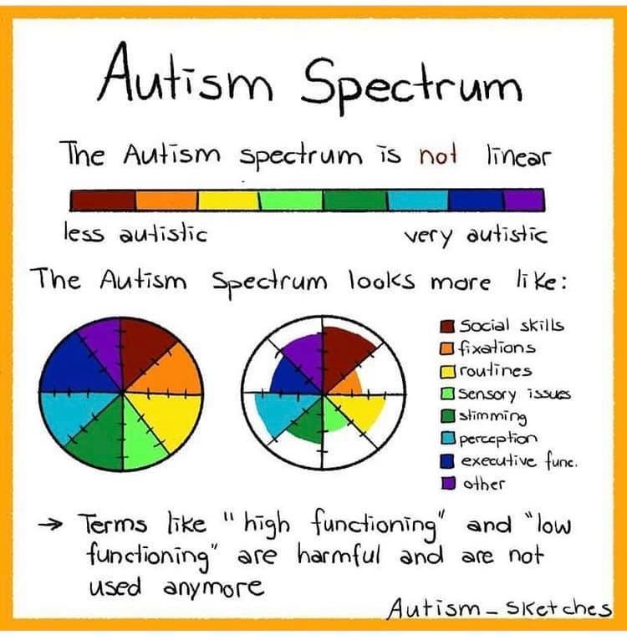
Autism Sketches [@Autism_Sketches]. (2021, March 30). Illustration depicting the spectrum of autism as a spiky profile [Image attached] [Post]. X. https://x.com/Autism_Sketches/status/1376871301311250434
Notes:
Autism is referred to as a spectrum because it is not a uniform and linear diagnosis.
Every autistic child is different, with diverse strengths and challenges.
Stereotypes and generalizations about autism are often misleading.
Terms like "high-functioning" or "low-functioning" are outdated and can be harmful.
Each autistic person has unique areas of strength and areas needing support.
No two autistic profiles are the same; they are often described as “spikey” profiles.
A “spikey” profile means some abilities are highly developed, while others may be less developed.
Examples include:
A person with a PhD in physics who struggles with daily hygiene tasks.
A non-verbal individual who excels in art or creative activities.

Slide 13

Autism and Stereotypes
Ethan’s Story (14 mins): https://www.youtube.com/watch?v=Ks21rwbYgbI
After watching, what are two “Aha’s” and a “Hmmm” that you may have about autism stereotypes?
Notes:
Autism is riddled with stereotypes. We chatted about this in our last session, and I shared that my son is subjected to some stereotypes, such as being rude, not having a filter, or appearing too robotic with his responses or body gestures. It's essential to challenge the common stereotypes about autism, which often paint a narrow picture of what it looks like. Some people may assume that all autistic children have the same abilities or struggles, but we know that autism is a spectrum, and each child’s experience is unique. Instead of assuming that all children will fit a specific mold, we recognize that strengths and challenges can appear differently. I will play a short video – here, Ethan, a teenager with autism, will share his experiences with autism stereotypes. As this video plays, please think about 2 “ahas” or things that make you relate to or click with his story – if you have any “hmms” It might be something you don’t fully agree with yet, or maybe it’s a new idea you’re still processing – please write those down as well.

Slide 14






Social Intelligence and Autism
:
Emotions/Empathy expressed differently (i.e., helping, sharing vs. words)
Strong 1-1 Connections (close relationships with few)
Honesty and directness (direct communication)
Observing before engaging (watch and understand before jumping in)
Unique social insight (noticing patterns and dynamics)
O’Neill, 2023, p. 78-80
Notes:
Chapter 4 of O’Neill’s book explores all 24 character strengths from an autistic perspective
It focuses on reframing traits often labeled as challenges into strengths
I will highlight five commonly misunderstood strengths as they are understood through the autistic lens
Starting with social intelligence, autism can appear different from what is typically expected
Double Empathy Theory, developed by Dr. Damian Milton (2012), explains mutual communication challenges between autistic and non-autistic people
Both groups have different ways of understanding and perceiving the world, leading to misunderstandings on both sides
For example, a teacher may expect a student to ask for help, but the student may instead withdraw, leading both to feel misunderstood
The theory highlights that communication difficulties are mutual, not solely the autistic person's issue
Autistic children may show empathy through actions like helping or sharing, rather than through expressions or words
They often form deep connections with a few individuals instead of seeking large group interactions
Their direct communication style can build honest and meaningful relationships
Many prefer to observe before engaging socially; taking in details, noticing patterns of behaviour, demonstrates careful thought and awareness of situations
They may detect subtle social patterns that others miss, offering valuable and unique perspectives even if their responses may be construed as unconventional

Slide 15






Love of Learning and Autism
Deep focus on special interests (intense enthusiasm for particular topics)
Independent/self-driven learning (teaching themselves skills, complex ideas)
Strong memory for details and facts (able to organize and remember information easily)
Asking deep questions (complex, specific, out-of-the-box questions)
Learning for joy (learning because they love to learn)
O’Neill, 2023, p. 65-66
Notes:
Autistic children often show a unique love of learning that may be different from typical expectations around how we learn or our typical learning experiences
They may focus intensely on specific interests such as dinosaurs, space, or history (hyper-interest/hyper-focus)
This deep focus leads them to explore topics in great detail, often teaching themselves how to do things, even more advanced concepts
Strong memory - helps them hold on to and and organize large amounts of information in areas they care a lot about
They often ask deep or unexpected questions that show curiosity and a unique way of thinking
Their motivation to learn usually comes from genuine enjoyment…. rather than outside rewards like grades or even praise from others (learning for the love of learning)

Slide 16






Kindness and Autism
Quiet acts of care (i.e., helping, fixing objects, sharing toys)
Practical helping (i.e., finding objects, solving a problem)
Respecting personal space (mindful of others’ boundaries)
Care of animals or younger children (more intuitive communication with pets/young ones)
Kindness without needing recognition (kind for the sake of being kind, social understanding)
O’Neill, 2023, p. 77-78
Notes:
Kindness in autistic children may appear different thank neurotypical children
They often show care through quiet actions (offering a snack or favourite object to you, fixing things, or including others)
Their kindness may appear to look more practical rather than emotional, such as solving problems or finding lost items, acts of service
Many are mindful of personal boundaries and show kindness by respecting others’ space (please note that just as with all these points, this is not always the case – there are children on the ASD spectrum that also commonly need reminders and work around physical and emotional boundaries)
They may express deep care for animals or younger children, where interaction feels more natural/innate/less pressured
Their kindness is often shown without seeking recognition, through loyalty and intentional actions rather than words or gestures

Slide 17






Perseverance and Autism
Purposeful repetition (practicing skills over and over, great determination)
Focus on what matters to them (topics of high interest)
Unique problem-solving (may need extra time, but will not give up)
Slow and steady progress (growth over time)
Determination in routines (insistence on consistency)
O’Neill, 2023, p. 89-90
Notes:
Perseverance in autistic children may look different from what is typically expected
They may practice things repetitively, like building the same LEGO design or rereading a beloved book
Repetition (sometimes more negatively framed as perseverating) reflects strong commitment and determination in the areas they care a lot about
Their perseverance may show in personal interests rather than standard school tasks or goals
They may take longer to complete tasks due to thoughtful or unique approaches, not because of a lack of effort
Their progress can seem slow, but it is steady and persistent over time
Many children with ASD demonstrate a strong focus and determination through routines or structured activities: demonstrates a commitment to what gives them a sense of stability, predictability, and (importantly) comfort

Slide 18



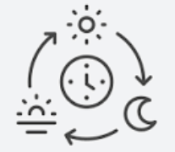


Self-Regulation and Autism
Using stimming to self-soothe (spinning, flapping, chewing, sipping, tugging, etc.)
Seeking out or avoiding sensory experiences (wearing headphones, avoiding crowds, seeking quiet space, etc.)
Seeking out structure and routine(the use of exercises, rituals, and predictable habits offers comfort and safety)
Can use calm down tools and strategies to regulate (naming emotions, breathing, walking away, co-regulation)
Expressing feelings (naming emotions, feelings in the body, scripted speech)
O’Neill, 2023, p. 90-92
Notes:
Autistic children often regulate emotions in ways that may look different from neurotypical children
They may commonly use stimming, such as rocking or flapping, to self-soothe
They often seek out or avoid specific sensory input, like seeking out certain feelings in the body (movements, tactile experiences like running sand through fingers, or chewing on clothing), or avoid uncomfortable sensory situations (such as wearing headphones, avoiding certain foods, or preferring quiet spaces)
Routines and structure help them feel safe, remain in control, and better able to manage emotions
They may need more time to calm down,, regulate, and transition between activities
Emotional expression and recognition of emotions and how they feel in the body may be different; recognizing or naming feelings can take time
Some children use literal language or scripted phrases to describe emotions (“My heart is beating fast!” = worry/excitement/anger
Others may show emotions through externalizing or internalizing behaviors, withdrawal, or intense reactions
A child might feel deeply but appear calm on the outside, or express love and care through actions rather than words
What seems like a lack of emotion may be a different way of processing or expressing feelings
Parents should look beneath the surface, model emotional language, model strategies, and allow space for their child to express feelings in their way and time

Slide 19
How could our child’s unique perspective help us see strengths others might miss?
Notes:
I want to do a quick group check in – thinking about your child, what strengths do you think they have that others may miss or misunderstand?

Slide 20
Take Home Task:
Think about the future: what could your child’s future be/look/feel like as they continue to grow in their strengths? What might that mean for them if their strengths keep developing in a year or two? What exciting possibilities do you see ahead for them?
For example: “Seeing how much more confident my child has become this year at speaking in front of the class and taking more risks socially, makes me imagine them one day leading a group project with ease.”

Slide 21
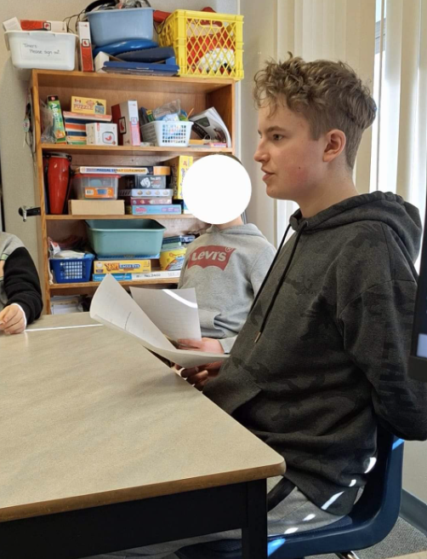
Human resources slide 4
Using strengths to envision what might be
Guiding question:
What might be possible if you used your strengths to the best of your ability?
Gratitude:
“Gratitude will help me long term by making sure that people know I recognize the effort they give to me; gratitude to my teachers and my classmates help me to stay positive (and to be known as a positive and easy to work with person).”
Love:
“Golden Rule: treat others how you would like to be treated.
There might be a few cases where I might make a wrong assumption of how people are feeling, but I always want to help, because that is the right thing to do.”
Perseverance: “This is an important strength because it helps me get ready for the real world: you need to focus energy into something if you want to complete it well”
Social Intelligence:
“This strength has grown since my high school years, and as I get into the upper years of high school, I am forming more bonds with people and taking risks to try new activities.
I focused on improving it because of the expectations in the school setting – such as collaborating on group projects, knowing what skills I would need to be successful.”
Hope: “Hope is important because having a better outlook on life can affect your mental health in positive ways
There is a comfort in knowing everything will turn out okay in the end.”
https://www.viacharacter.org/
Notes:
(review Erik’s example of how he envisions his strengths contributing to his future)

Slide 22
Thank you!
Next Session: Wednesday, May 14th
Do you have any questions?
hagblom@unbc.ca
Notes:
Thank you so very much! You folks are such a beautiful group, and I appreciate you so much! Next session we will be diving into the Explore part of our ideas framework, and I will be sharing some ways that you can continue to explore identified strengths with your child. As always, I will post resources on the website. Please do not hesitate to reach out if you have any questions. I will hang around here for a little bit if you have any other questions, otherwise I look forward to our fourth session next week!

Slide 23
References
.
Milton, D. E. M. (2012). On the ontological status of autism: The ‘double empathy problem’. Disability & Society, 27(6), 883–887. https://doi.org/10.1080/09687599.2012.710008
Niemiec, R. M. (2017). Character strengths interventions: A field guide for practitioners. Hogrefe Publishing.
O'Neill, C. (2023). The strengths-based guide to supporting autistic children: A positive psychology approach to parenting. Jessica Kingsley Publishers.
Kingsley, E. P. (1987). Welcome to Holland. https://www.our-kids.org/Archives/Holland.html

