Slide 1

Empowering Parents: Session #5
Welcome Back!
May 21, 2025
Notes:
Good evening everyone! Welcome back! I hope all of you had a wonderful long weekend and had a chance to relax.

Slide 2
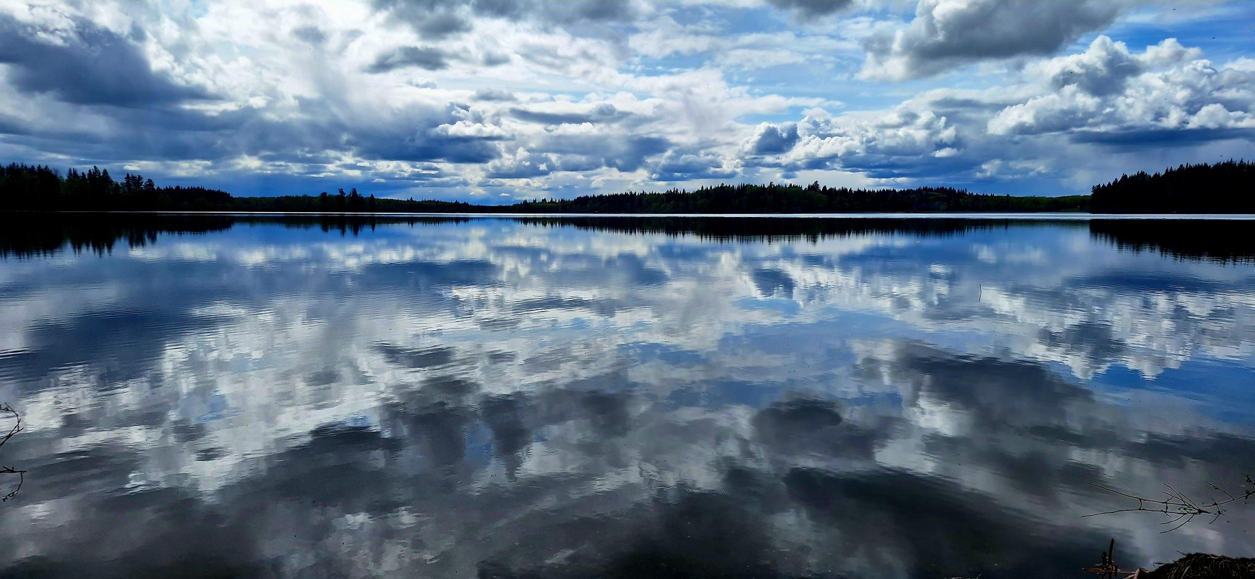
Grateful and humbled to be a guest on the beautiful and unceded territory of the Lheidli T’Enneh.
Notes:
As always, I am grateful and humbled to be a guest on the beautiful and unceded territory of the Lheidli T’Enneh. I felt I needed to update my picture of Nukko Lake – I took this on Friday on my way home from work. I recognize I am not taking the time I perhaps need to stop, pause and reflect – I am trying to slow down and take notice of the beautiful changing world around me as we inch into summer. As life gets busy, reflection helps you stay grounded in what truly matters.

Slide 3
Shape of Our Evening
2 Grounding/Check-In
1 Review of Group Norms
3 Group Share Out: Take Home Task Last Week – Mind Maps
5 Strength Overuse, Underuse, and Misuse
6 Tool to Regulate Strengths
4 Action Stage: Developing Strengths
7 Take Home Task
8 Final Thoughts & Questions

Slide 4


Disclaimer
https://northernbc.cmha.ca/find-help-now/
Notes:
Disclaimer:
I want to acknowledge that while I am a teacher and a graduate student, I am not a licensed therapist or mental health professional. The purpose of these sessions is to offer support, share educational insights, and provide a space for reflection and learning—not to provide therapy or clinical advice.
If at any point during our discussions you feel overwhelmed, uncomfortable, or in need of additional support, please know that help is available. I encourage you to reach out to a qualified mental health professional or access support services through the Canadian Mental Health Association at https://northernbc.cmha.ca/find-help-now/. Please know that your safety and well-being is incredibly important to us – please do not hesitate to reach out if you need support.

Slide 5
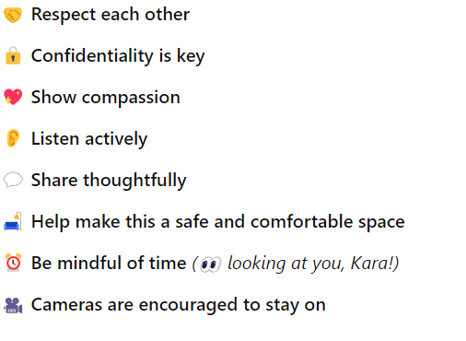
Group Norms

Slide 6

💛 Let’s Begin Together
🌿 Grounding Exercise – Take a moment to settle in
✍️ Quiet Think & Write – Think about a time this week when you tried something new or faced a challenge. How did it feel? What did you learn from it, even if things didn’t go perfectly? How can you use what you learned to keep getting better? (5 mins)
🗣️ Group Share – Let’s hear from each other (10 mins)
For the Heroes: A Pep Talk From Kid President (youtube.com)
Notes:
For our grounding exercise tonight, we are doing a bit of a throw back video – Kid President videos are a bit of an oldie but goodie. He is all grown up now, but if you ever need a pep talk or a boost of serotonin, Kid President is always a reliable source. This one goes out to all my heroes (that would be you.) As you watch, think about a time this week when you tried something new or faced a challenge.

Slide 7

Review of Take-Home Task:
Mind Maps
Notes:
Alright – now I want to hear from you – did anyone attempt a mind-map with your child? If so, I would love to have you share, maybe give us some highlights about your experience. What did you like about this? Did anything not work as well as you thought it might? Any aha’s or hmmm’s that came from the experience?

Slide 8
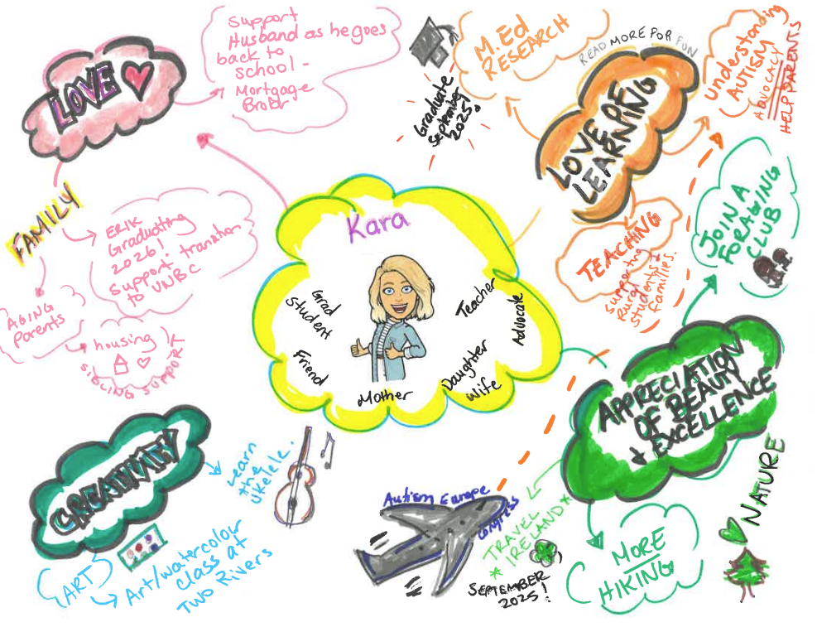
Notes:
Last week, I introduced the idea of mind-mapping to you. Just a quick reminder (in case you missed it), here is my mind map as an example. I pulled 4 of my top self-identified strengths – and attached goals to these strengths. (review the map)

Slide 9

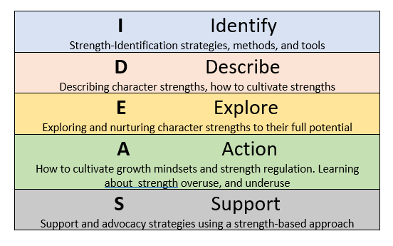


We are here.
Notes:
In the action phase, we will do exactly that – learn why it’s important to develop and regulate strengths, and take action to nurture strengths to their fullest potential. During this section, we will discuss how mindset plays a critical role in strength development and regulation, discuss how strengths can be at risk of being overused, underused, or misused, and discuss how we can work to find the sweet spot of strength optimization. We will also discuss specific actions you and your child can take to develop strengths.

Slide 10
17% of people use their strengths most of the time each day.
(Buckingham, 2017)
Notes:
Introduce Marcus Buckingham: British author, researcher, motivational speaker
Pioneer in strengths-based development
Research based on Gallup’s global workplace studies with millions of participants
· Found that only 17% use their strengths daily
The research suggests that using strengths daily improves performance and long-term well-being
Importance for autistic students: again, often assessed according to deficits, not strengths
Strengths focus builds self-confidence, motivation, and engagement
Helps autistic kids feel valued and capable
Supports individualized learning and growth

Slide 11
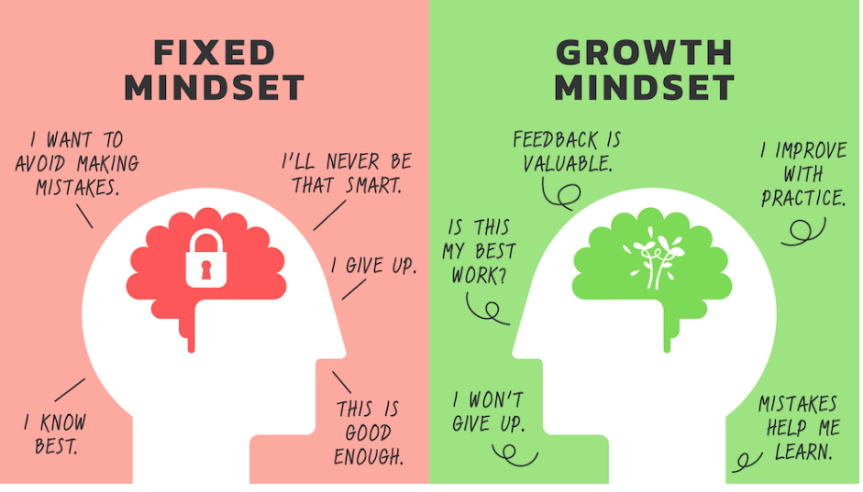
Growth Mindset Vs. Fixed Mindset
(Dweck, 2006)
https://www.innovationlearning.org/growth-or-fixed-mindset/
Growth Mindset For Kids-Growth Mindset vs. Fixed Mindset-The Power Of Yet-Elementary-Middle School (youtube.com)
Notes:
Fixed mindset:
Believes traits and abilities are unchangeable
Avoids failure, seeks perfection
Resists challenges, feedback, and risks
Wants to appear competent and skilled
Growth mindset:
Believes strengths can be developed and weaknesses challenged
Sees intelligence and talent as able to be improved through effort
Views mistakes as learning opportunities
Embraces persistence, challenges, and risks
Welcomes feedback and sees learning as an ongoing process

Slide 12
The Power of YET
Praise EFFORT over ABILITY
If at first not successful, consider:
    - Was activity at right level? (too hard, too easy?)
    - Physical/Environmental barriers? (too noisy, smelly, hungry, tired, nervous)
    - What other supports were absent? (different teacher, different space, absent EA, etc.)
    Add “yet” to how you speak with and about your child
      - “He can’t ride a bike….yet”
      - “She can’t read fluently…yet.”
      - “You can’t tie your shoes…yet.”
      Talk about neuroplasticity
        - Our brains are amazing and always changing!
        Use positive statements about strengths
        - “I am willing to try new experiences.” (curiosity)
        - “It’s okay to feel scared and ask for help.” (bravery)
        (Adler, 1963)
Notes:
The power of Yet is another important way we can shift our mindset into the growth zone. The power of yet is the idea that abilities and understanding can grow with time and effort—turning "I can't do this" into "I can't do this yet," which encourages persistence and a growth mindset. Here, our work becomes focused on recognizing the effort of our children (and ourselves) in attempting the challenges, instead of praising their ability to do it. The power of yet has us question what barriers were in place for our child (or ourselves) if they are not successful. It also asks us to shift our language – remember back when I spoke about how “can’t” is such a deflating word? When you add “yet,” it acknowledges that some skills take time to develop – learning takes patience and time, and effort matters. They may not be there yet, but their progress towards their goals means so much. When we talk about growth mindset, we often speak about neuroplasticity, or our brains ability to create new connections, pathways, and changes over time.
The power of yet reflects the concept of neuroplasticity..the brain's ability to grow, change, essential rewire itself,
With effort and learning, we CAN acquire new skills and understanding can and will develop over time (presuming competence – all children have the potential to learn and grow, even it it is at their own pace)
Positive statements combined with the power of yet help reframe our lens of challenges as being opportunities for growth and learning – our brain can literally rewire itself with intentional, patient, strength-oriented action

Slide 13
Strength Regulation
(Biswas-Diener et al, 2011)
Strength Overuse
Strength Underuse
Strength Misuse
Too much confidence
→ showing off
Too much bravery
→ risky behaviour
Too much attention to detail
→ perfectionist tendencies
Too little creativity → good ideas stay hidden
Too little leadership → Doesn’t step up when needed
Too little judgment
→ not making good decisions
Misuse of humour
→ using jokes to hurt or harm others
Misuse of teamwork
→ goes along with others’ ideas, if they don’t feel right
Misuse of confidence
→ jumps into situations without preparing enough
Notes:
In positive psychology, strength regulation involves recognizing and skillfully managing one's personal strengths—like courage, patience, or empathy—in a balanced way, so they support well-being and resilience without becoming overused or underutilized. In this way, strengths are wonderful to have, but we need to nurture them in the right way, or we risk underusing, overusing them, or misusing them, which can lead to harm to either our own development, or to those around us. For example…

Slide 14

Strength Self-Reflection and Monitoring
Daily reflection on strengths
With younger children, ask simple questions around dinner (ex., When were you kind today? What did you love to learn today?)
Can focus on one strength at a time
Older children might keep a simple reflection journal
Makes children more aware of there strengths and how they use them in different situations
Notes:
Monitoring and reflecting on your strengths is important because it helps you use them intentionally and effectively, avoid overusing them in ways that can become counterproductive, and continue growing by recognizing how your strengths can support your goals, relationships, and resilience.
Here, we intentionally bring focus to strengths – reflecting on them and making space for daily conversations around them.
This can look more casual, like asking how your child used kindness today, or how did they demonstrate their love of learning.
It may be helpful to focus on one strength at a time (it can be a lower or middle strength that you may way to cultivate more, such as self-regulation.
You can keep a simple journal so you can track these reflections over time (depending on the age of your child).
Really, we want to make our children more aware of their strengths. Reflecting on and helping your child regulate their strengths in autism allows you to support them in using their unique abilities to overcome challenges and build confidence in a way that feels empowering and manageable.

Slide 15
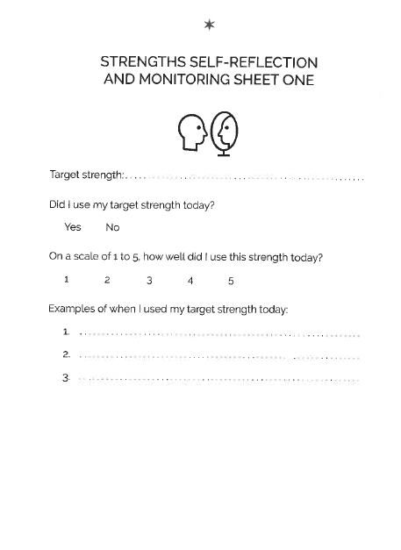
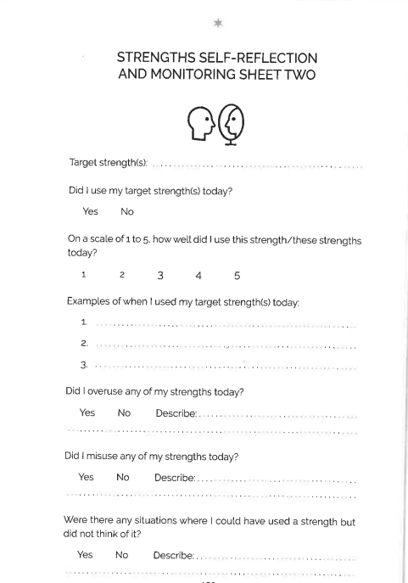
(O’Neill, 2023, p. 149-150)
Notes:
In the book, O’Neill presents a few templates of how we can have our children (or ourselves) self-reflect and monitor strengths. I will also link these on the website. The first one picks one target strength – asks the child if they used it today – has them rate it (discuss the rating system in advance), and gives some good examples of how they used it. The second template gets a little more detailed, as it includes a section around misusing strengths or having your child think about a situation where they could have used a strength but did not think of it.

Slide 16
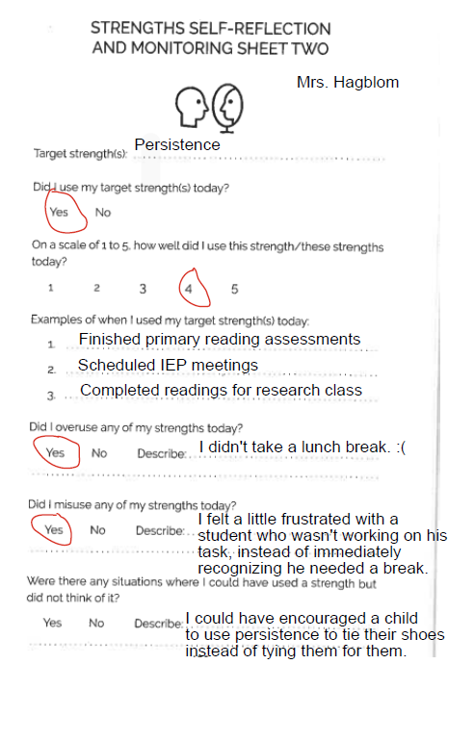
Notes:
(review how I used Persistence today)

Slide 17
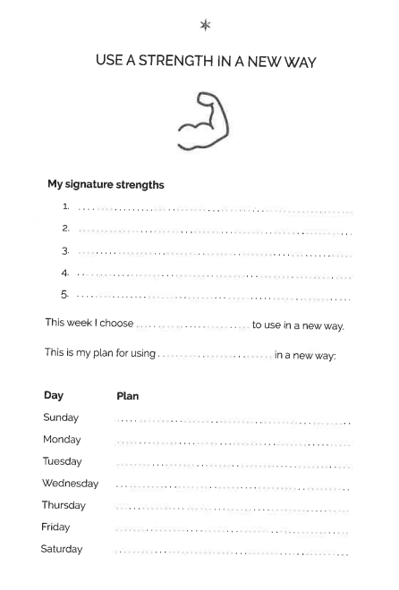
Using a Strength in a New Way
(Gander et al., 2013, Seligman et al, 2005)
Pick on a signature strength
Think of ways to use it in a new way for a week
Record in strengths diary or on a reflection sheet
Review with your child: what went well?
You can also use this to develop a lower strength (i.e., self-regulation)
(O’Neill, 2023, p. 151)
Notes:
Using a skill or strength in a new way helps your child grow, try new things, and feel more confident by showing them they can adapt and succeed in different situations. Here. We are working to have your child pick a top strength

Slide 18
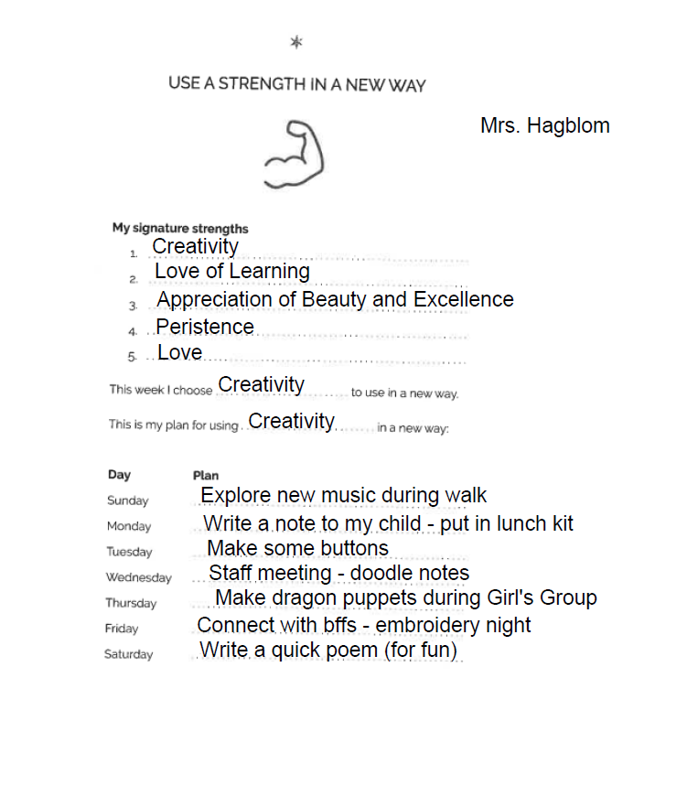

Slide 19

Examples of Using a Strength in a New Way
Creativity → Solves a problem at home in a unique way (e.g., chore chart as a game)
Kindness → Helps a new student feel welcome
Leadership → Organizes a group activity during recess, not just taking the lead in class
Teamwork → Works with parents to plan a family night
Curiosity → Asks thoughtful questions to understand a friend’s feelings
Bravery → Tries a new food or joins a new club
Humour → Uses jokes to cheer up a sad friend, not just to be silly
Notes:
(more examples to share with group)

Slide 20
Acting As If
(Adler, 1963)
Select a strength (this can be a middle or lower strength)
Choose a situation to use this strength in a way that is just outside of your child’s comfort zone (i.e., trying a new social situation)
Help your child visualize using their strength in this situation – use the senses
Use lots of praise for the effort involved
Notes:
Adler's idea of "acting as if" suggests that if your child visualizes using a skill, they can start to believe in themselves and gradually develop those qualities, helping them tackle challenges with more courage.

Slide 21


As If: Example
Before a social event (e.g., birthday party), the parent says:
“You are so good at watching and noticing what the other kids are doing. It looks like they are having a lot of fun! I know you can join in when you feel ready.”
The parent also acts as if: showing that they believe the situation is manageable, even if they feel anxious inside. Calm, trusting tone and body language is important.
Afterward, offer praise/positive reinforcement for the child’s effort:
“You had so much fun playing tag with the other kids! I could see you watching and deciding the right time to join in - that was smart thinking!”

Slide 22

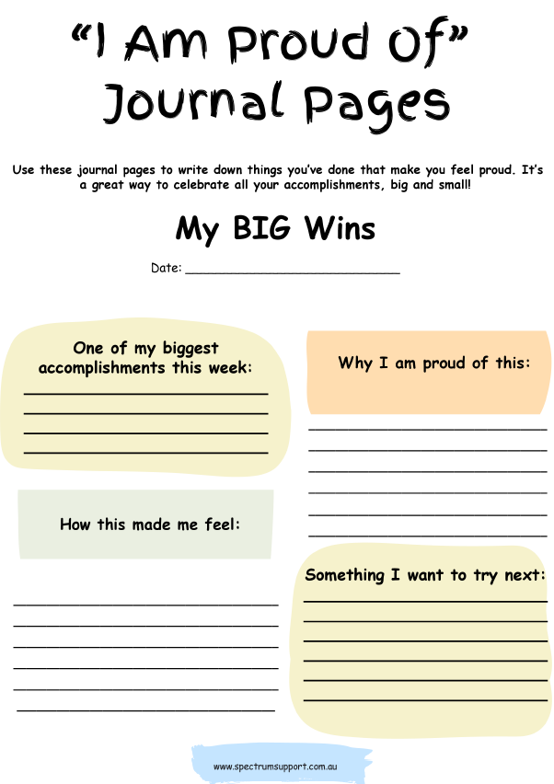
Autism Helper. (n.d.). Journal prompts: Build confidence. Teachers Pay Teachers. https://www.teacherspayteachers.com/Product/Journal-Prompts-Build-Confidence-Autism-Helper-Strengths-Writing-Activity-Lesson-12938104
Notes:
This is another resource I found and will include on the website – this is a “I am Proud of” journal, and ties into helping your child stay reflective about how they used their strengths and skills to find pockets of time in their day where they recognized what they did well, when they tried something new, when and to who they were kid, and something they want to try next.

Slide 23
Reflection: How do the attitudes of adults around your child—at home or school—help or hold back their strengths? How could a growth mindset help support your child while still honoring who they are?
Notes:
Before we jump further, I am going to return to the group for a quick reflection, without naming specific names, keeping information general

Slide 24


Take Home Task:
Pick one of the strategies we discussed (Strength Reflection and Monitoring, Using a Strength in a New Way, Acting As If, Confidence Journal) and try it out with your child.

Slide 25
Thank you!
Next Session: Wednesday, May 28th
Do you have any questions?
hagblom@unbc.ca

Slide 26
References
Adler, A. (1963). The individual psychology of Alfred Adler: A systematic presentation in selections from his writings (H. L. Ansbacher & R. R. Ansbacher, Eds.). Harper &
Row.
Autism Helper. (n.d.). Journal prompts: Build confidence. Teachers Pay Teachers. https://www.teacherspayteachers.com/Product/Journal-Prompts-Build-Confidence- Autism-Helper-Strengths-Writing-Activity-Lesson-12938104
Buckingham, M. (2007). Go put your strengths to work: 6 powerful steps to achieve outstanding performance. Free Press.
Gander, F., Proyer, R. T., Ruch, W., & Wyss, T. (2013). Strength-based positive interventions: Further evidence for their potential in enhancing well-being and alleviating depression. Journal of Happiness Studies, 14(4), 1241–1259. https://doi.org/10.1007/s10902-012-9380-0
Dweck, C. S. (2006). Mindset: The new psychology of success. Random House.
Gander, F., Proyer, R. T., Ruch, W., & Wyss, T. (2013). Strength-based positive interventions: Further evidence for their potential in enhancing well-being and alleviating depression. Journal of Happiness Studies, 14(4), 1241–1259. https://doi.org/10.1007/s10902-012-9380-0
Seligman, M. E. P., Steen, T. A., Park, N., & Peterson, C. (2005). Positive psychology progress: Empirical validation of interventions. American Psychologist, 60(5), 410– 421. https://doi.org/10.1037/0003-066X.60.5.410
Novak, R. [Kid President]. (2015, October 6). For the heroes: A pep talk from Kid President [Video]. YouTube. https://www.youtube.com/watch?v=tgF1Enrgo2g

